Slide 1
Congruency
EQ: How can we determine congruency in triangles?

Slide 2
From last class
Task: In Groups
What are the properties of the quadrilaterals?
Hint –
Sides, angles, diagonals
Rectangle | Square | Rhombus
Kite | Trapezium | Parallelogram

Slide 3
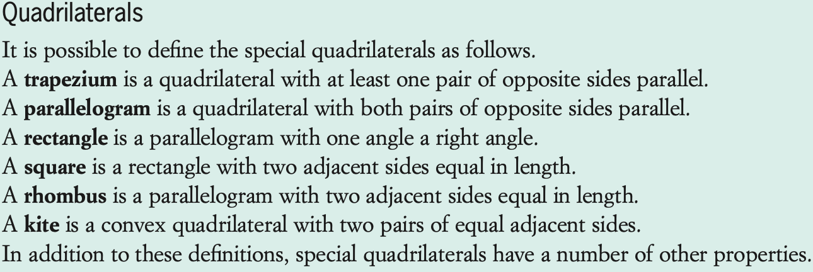
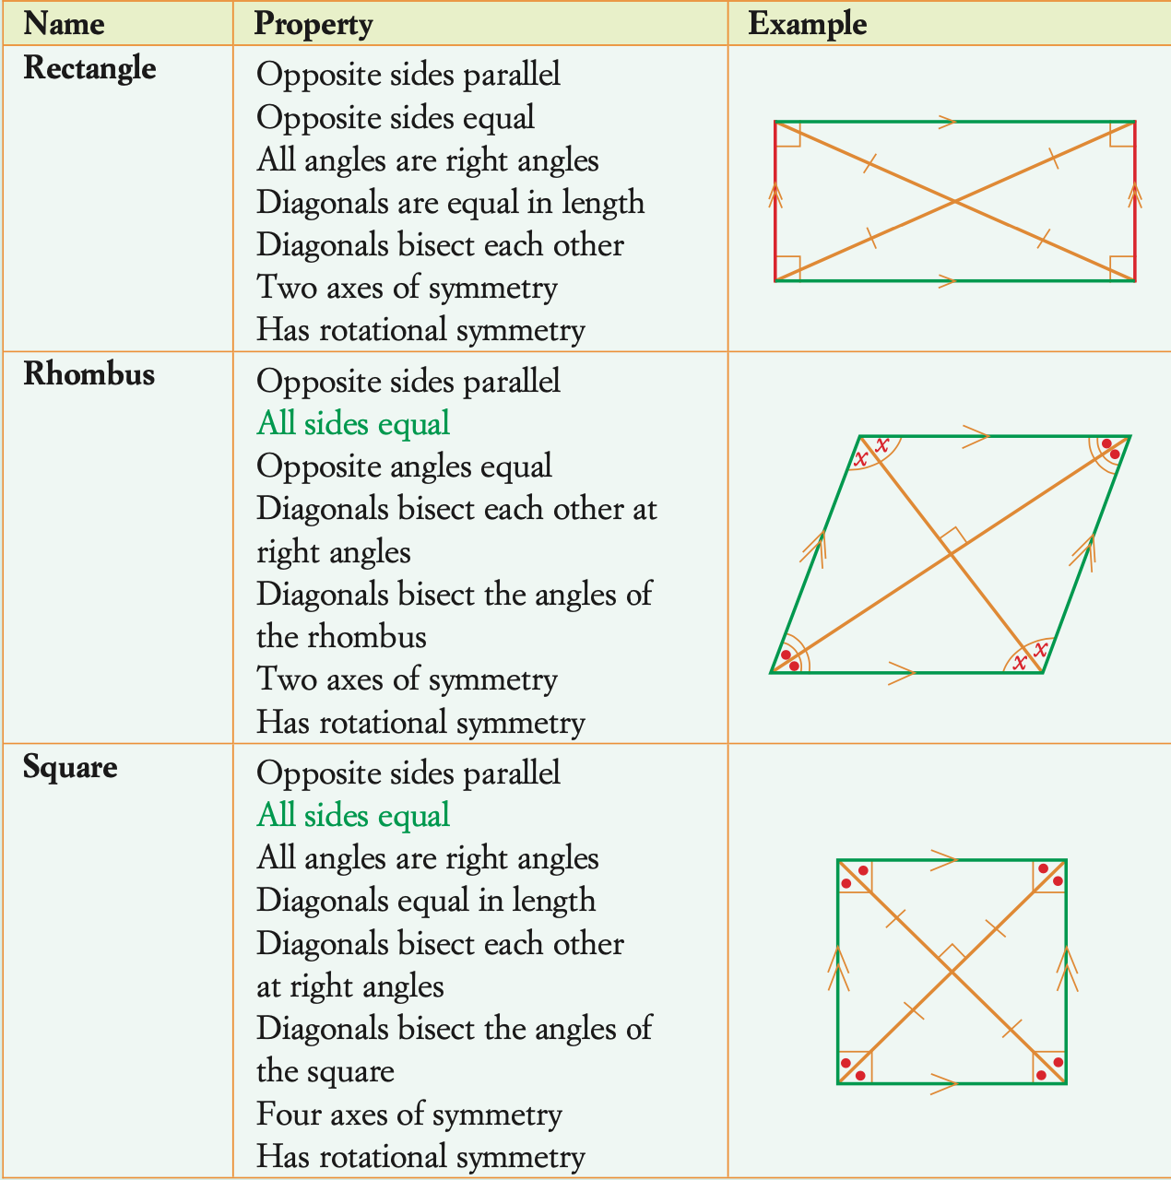
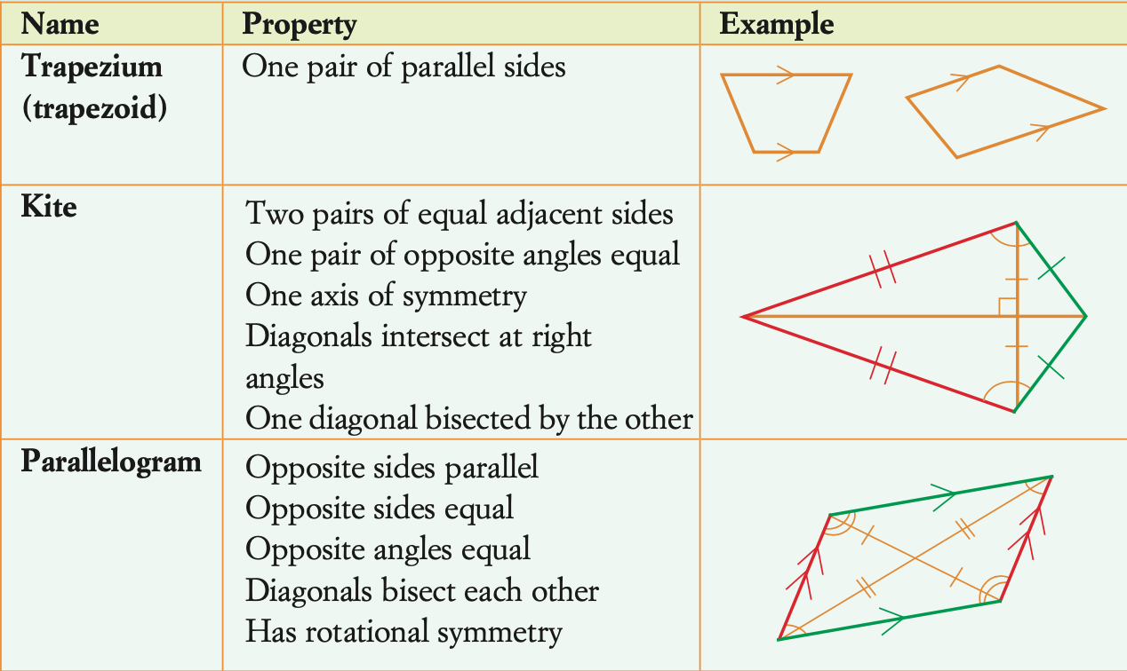

Slide 4
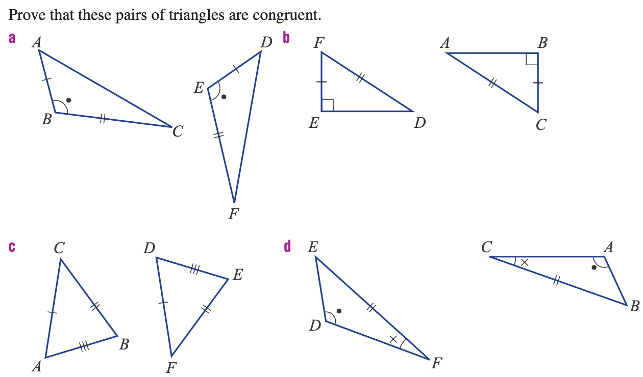
Last year you learned 4 proofs of congruency for triangles. Working in groups of 2-4, use the below questions to come up with those 4 proofs!

Slide 5
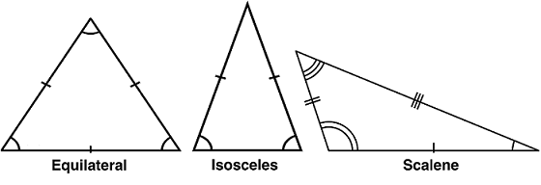
Topic: Congruency in Triangles
EQ: How can we determine congruency in triangles
Triangles are made of three angles, and three sides.
Triangles can be classified into three types: Scalene, Isosceles and Equilateral.
A scalene triangle has all three sides and angles different.
An Isosceles triangle has two sides of the same length and two angles that are the same
An Equilateral triangle has all sides and angles the same.
The word Congruent means “in identical forms; Coinciding when super imposed”
This means that you could increase or decrease either triangle and they would match up exactly.

Slide 6
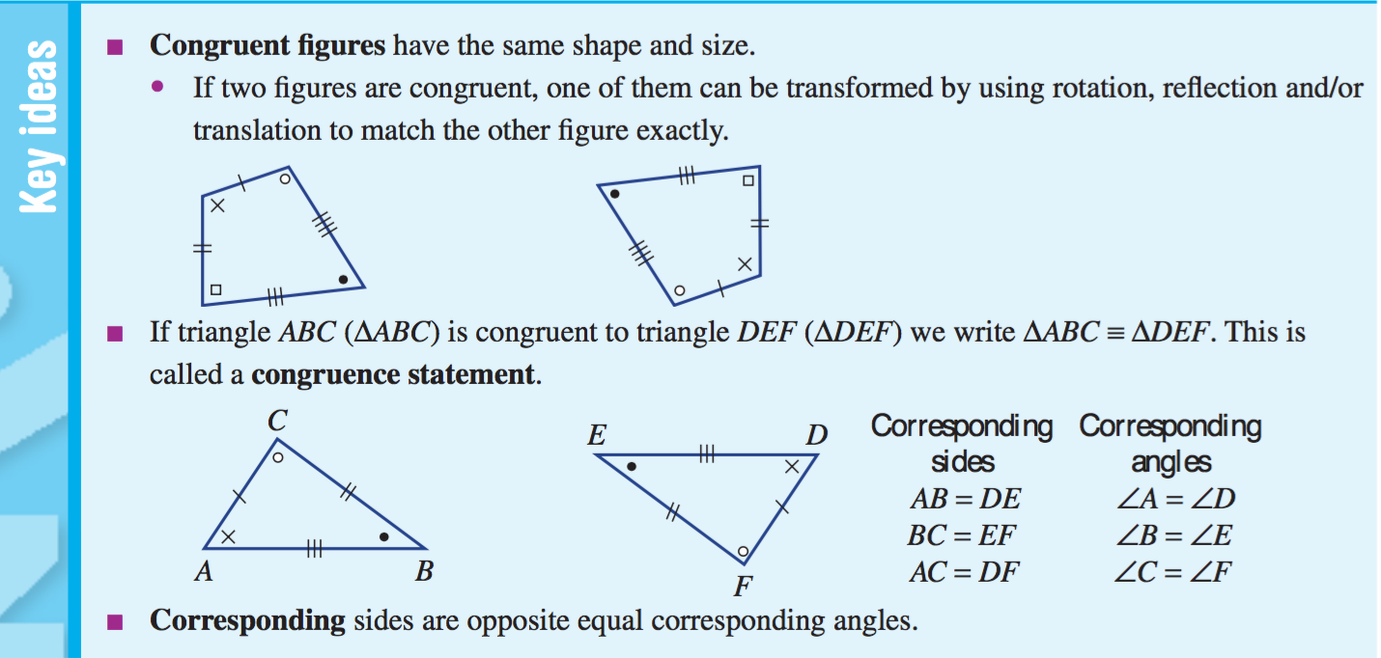
Topic: Congruency in Triangles
EQ: How can we determine congruency in triangles
When looking at two triangles, we need to see if the triangles share the same features – angle size, side length and shape type (a square is not congruent with triangle, even if they both have a right angle)

Slide 7
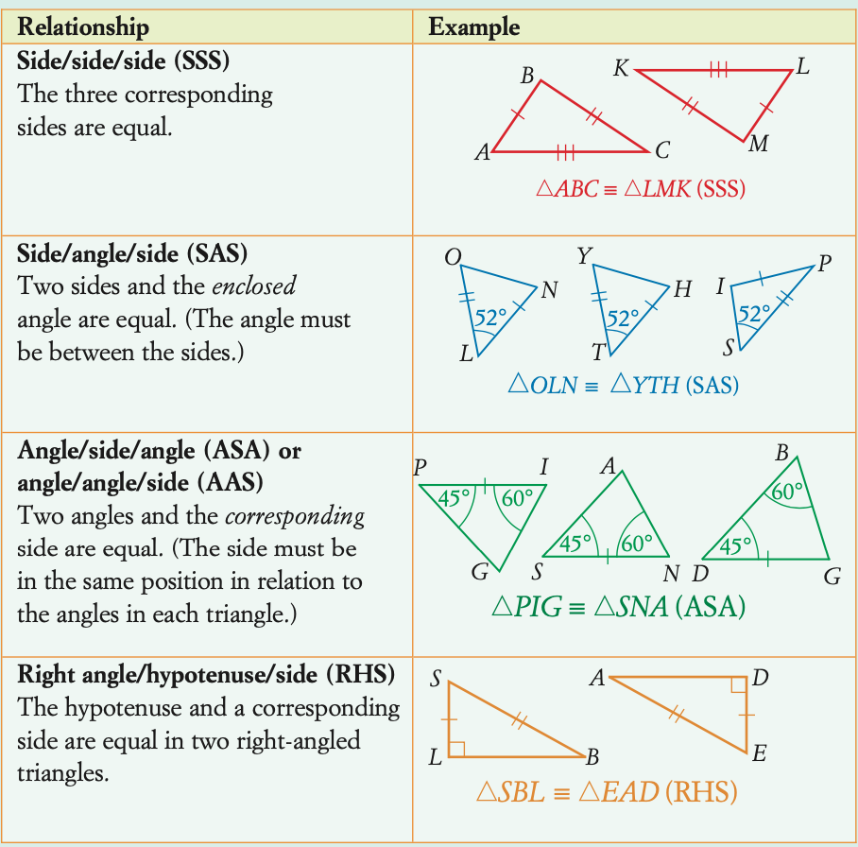
Topic: Congruency in Triangles
EQ: How can we determine congruency in triangles
When looking for congruency in triangles, there are tests we can perform to find out if the triangle is congruent to another or not. The four of them are:

Slide 8
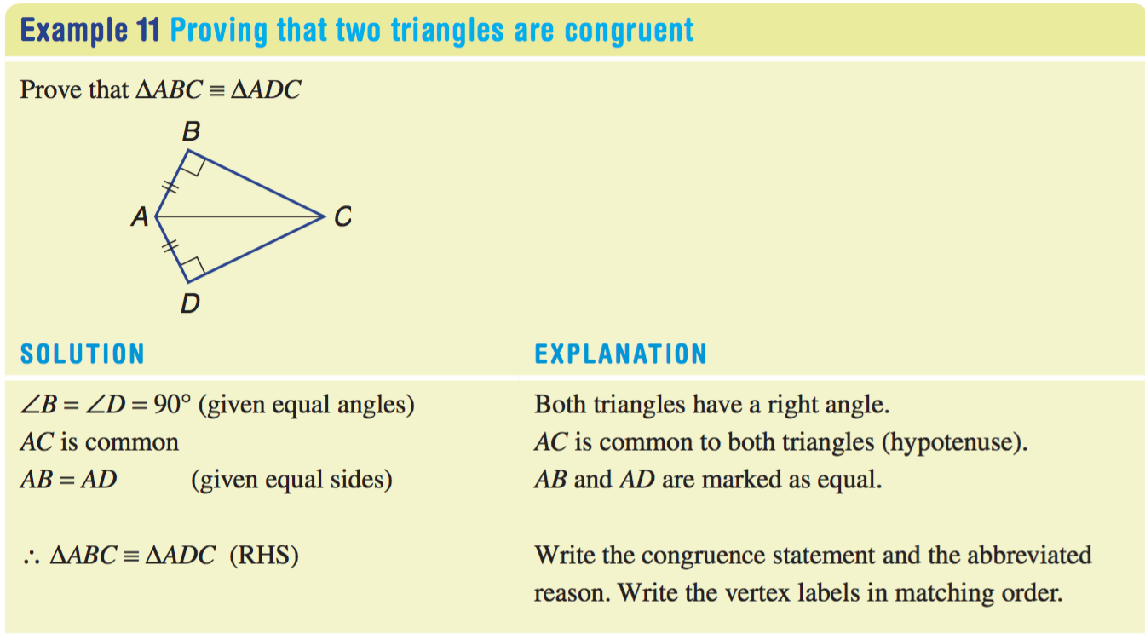

Topic: Congruency in Triangles
EQ: How can we determine congruency in triangles
EXAMPLE CONGRUENCY

Slide 9
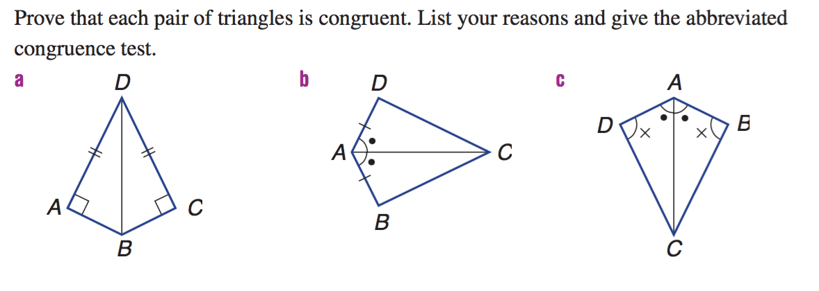
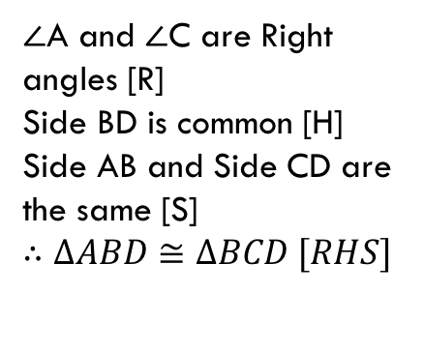
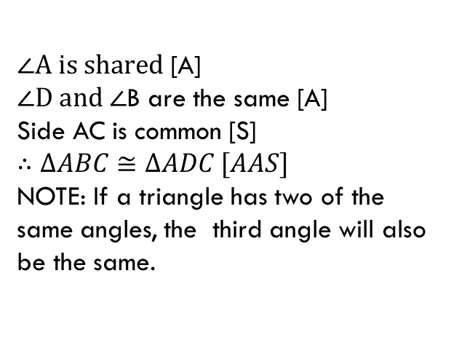
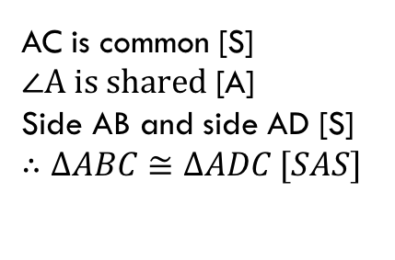
Topic: Congruency in Triangles
EQ: How can we determine congruency in triangles
$∠A is shared$ [A]
$∠D and ∠$B are the same [A]
Side AC is common [S]
$∴$ $∆ABC≅∆ADC [AAS]$
NOTE: If a triangle has two of the same angles, the third angle will also be the same.
$∠$A and $∠$C are Right angles [R]
Side BD is common [H]
Side AB and Side CD are the same [S]
$∴$ $∆ABD≅∆BCD [RHS]$
AC is common [S]
$∠A is shared$ [A]
Side AB and side AD [S]
$∴$ $∆ABC≅∆ADC [SAS]$

Slide 10
Complete Worksheet

